Slide 1

Introduction to Data Science

Slide 2
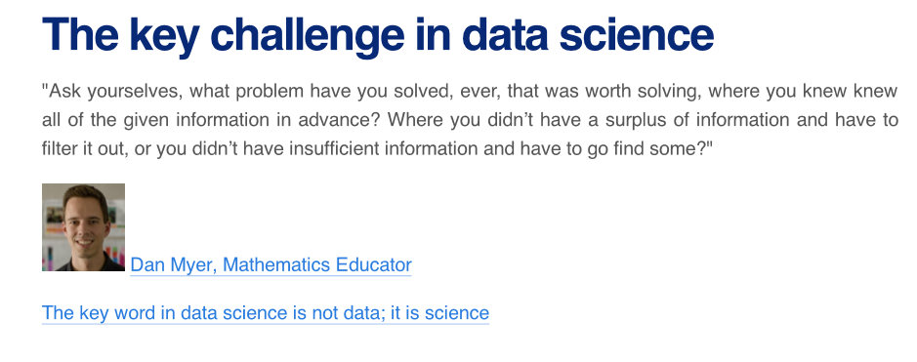
Data Science

Slide 3
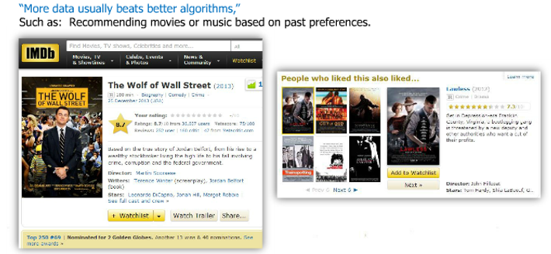
Data Science

Slide 4
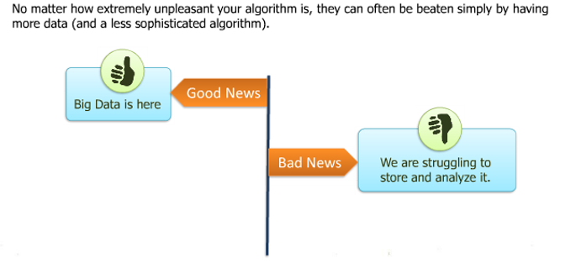
Data Science

Slide 5
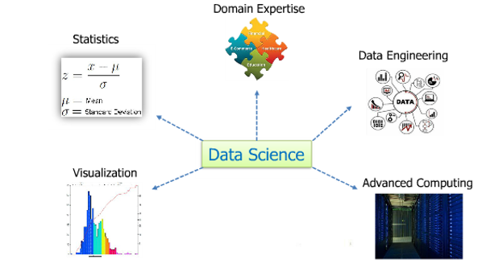
Data Science Components

Slide 6
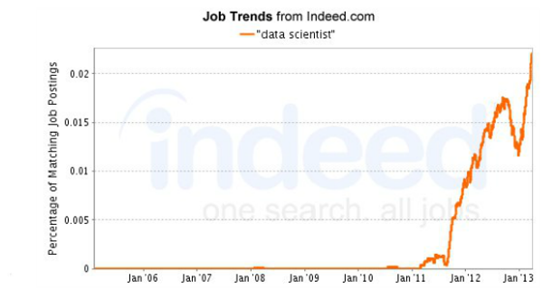
Data Science Prospects

Slide 7
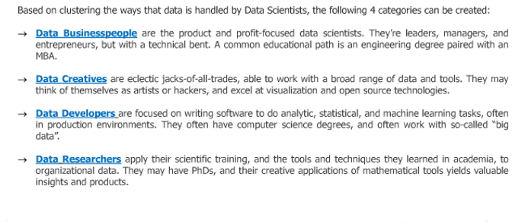
Types of Data Scientists

Slide 8
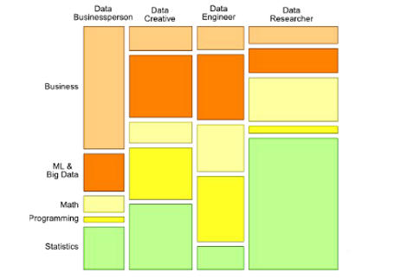
Data Scientists – Skill Groups

Slide 9
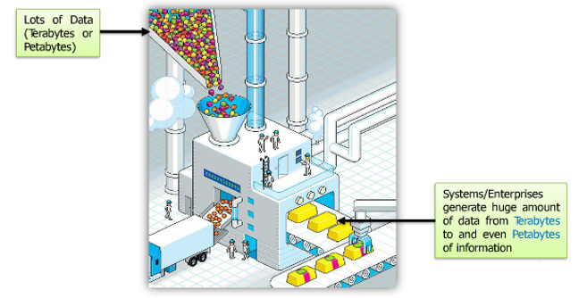
What is Big Data

Slide 10
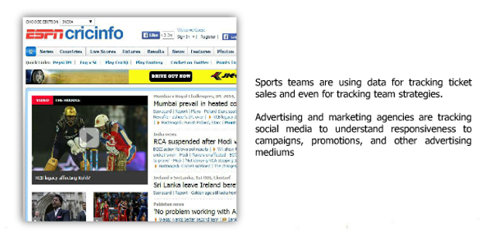
Big Data- Scenarios - Sports

Slide 11
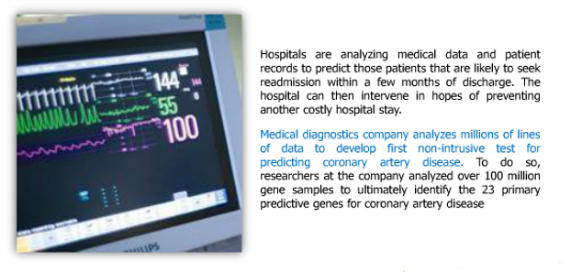
Big Data- Scenarios – Hospital Care

Slide 12

Big Data- Scenarios – Amazon

Slide 13
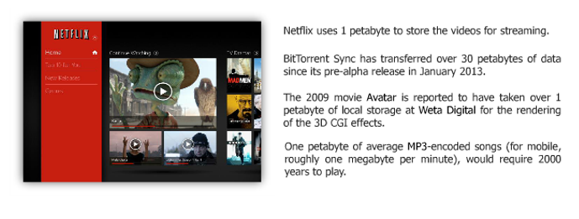
Big Data- Scenarios – NetFlix

Slide 14
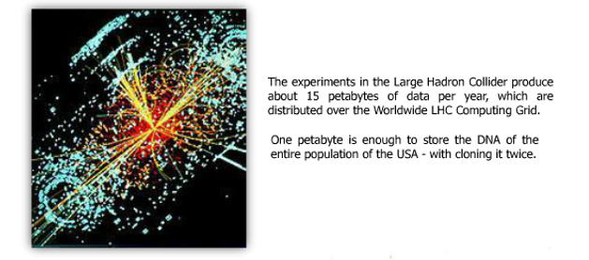
Big Data- Scenarios – Large Hadron Collider

Slide 15
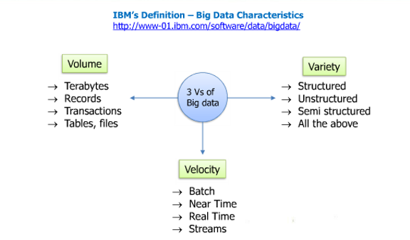
Big Data- IBM Definition

Slide 16
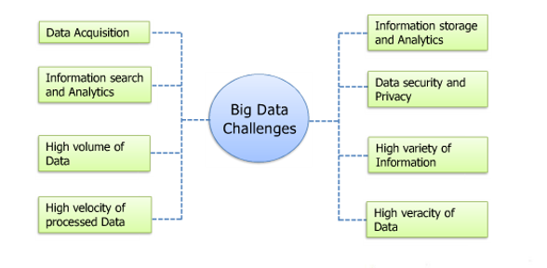
Big Data: Challenges

Slide 17
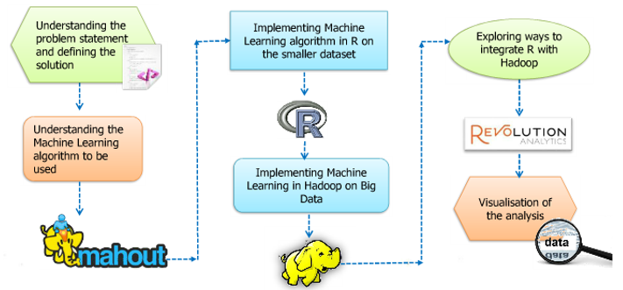
Use Case Implementation

Slide 18
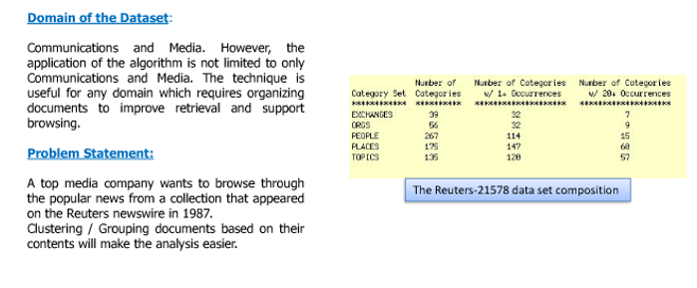
Media Use Case

Slide 19
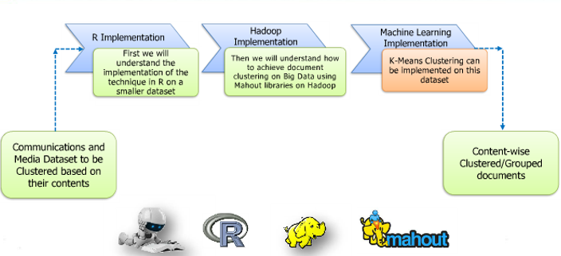
Media Use Case - Clustering

Slide 20
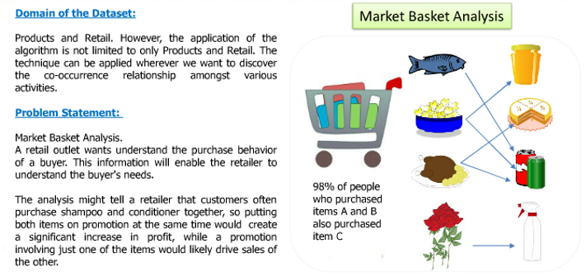
Market Basket Use Case

Slide 21
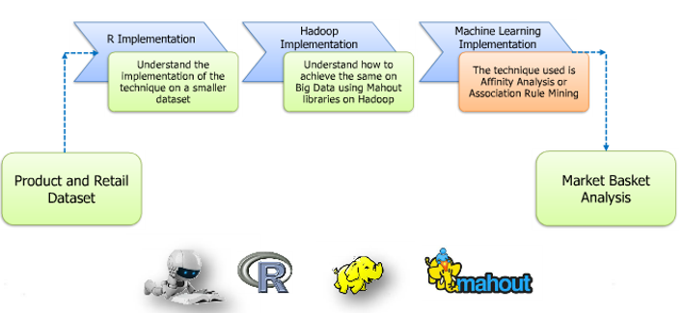
Market Basket Use Case: Association Rule Mining

Slide 22
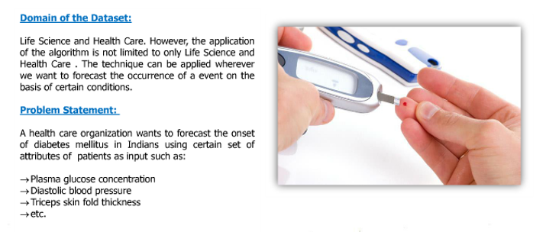
Health Care Use Case

Slide 23
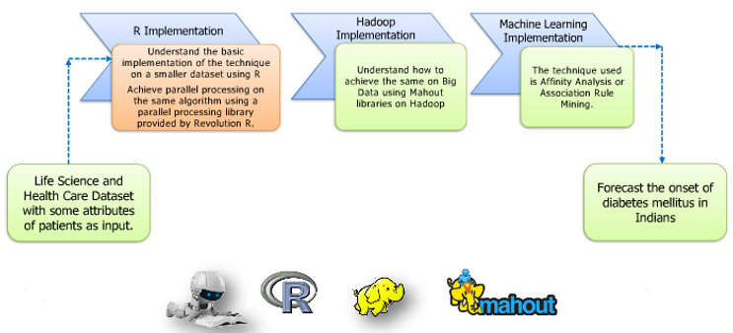
Health Care Use Case –Parallel Processing

Slide 24
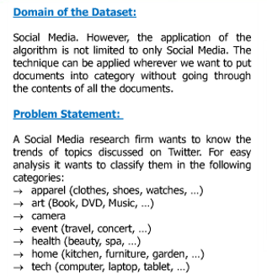
Social Media Use Case

Slide 25
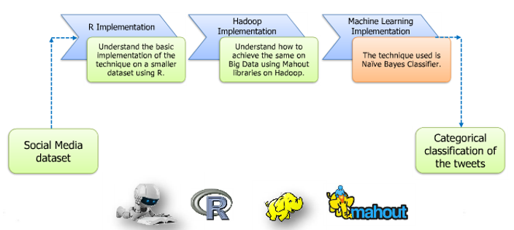
Social Media Use Case – Naïve Bayes Classifier

